Slide 1
Supplemental Figure 1.
A
Patients with LA-NSCLC
treated with concurrent CRT
n = 108
2012–2015 cohort
From Jan 2012
to Jun 2015
n = 52 (48%)
2015–2018 cohort
From Jul 2015
to Jun 2018
n = 56 (52%)
B
Ineligible
34 (31%)
Eligible
74 (69%)
Notes:
PACIFIC Criteria

Slide 2
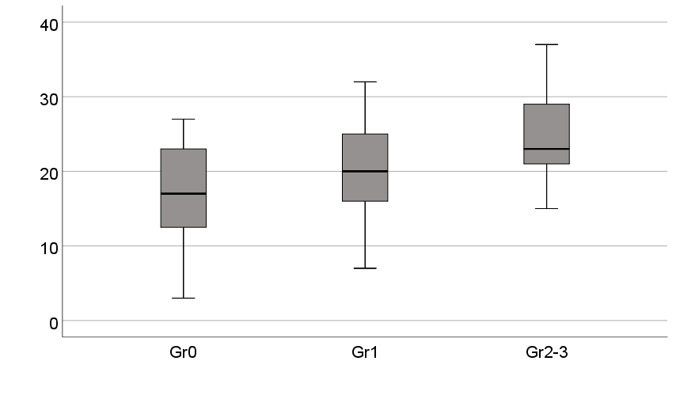
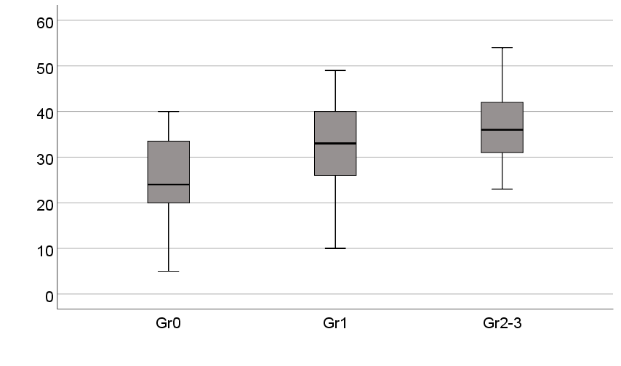
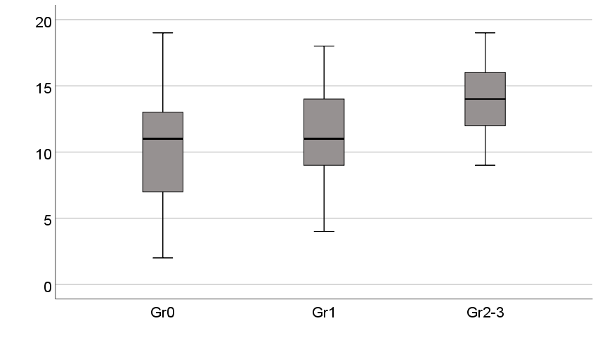
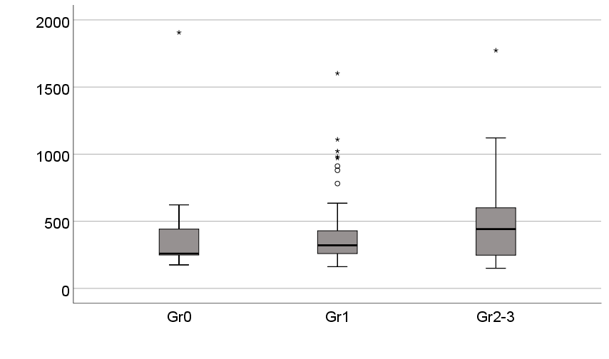
Supplemental Figure 2.
A
p=0.049
B
p=0.003
p=0.25
p=0.029
p=0.56
p=0.024
V5 (%)
V20 (%)
V5 (%)
Gr0
Gr1
Gr2-3
Gr0
Gr1
Gr2-3
C
p=0.004
D
p=0.41
p=0.32
p=0.042
p=0.75
p=0.28
Mean lung dose (Gy)
KL-6 (U/mL)
Gr0
Gr1
Gr2-3
Gr0
Gr1
Gr2-3

